Slide 1
Create an AMI of an Existing EC2 Instance
and Launch a New Instance from It
AWS | EC2 | AMI | EBS | IAM | VPC
Team Members:
Devanshi Chauhan
Abhay Kumar
Saumya Raghav
Sarthak Chaudhary

Slide 2
PROBLEM STATEMENT
Problem Statement
  Time-consuming
  Repetitive
  Prone to Error
  Difficult to maintain consistently
  Difficult to scale

Slide 3
PROJECT OVERVIEW
  Configure an existing Amazon EC2 instance as a source server.
  Install and configure a simple Nginx web server.
  Create a custom Amazon Machine Image (AMI).
  Launch a new EC2 instance using the custom AMI.
  Validate application and configuration consistency.
Project Workflow
EC2-A → Configure → Create AMI → Launch EC2-B → Validate

Slide 4
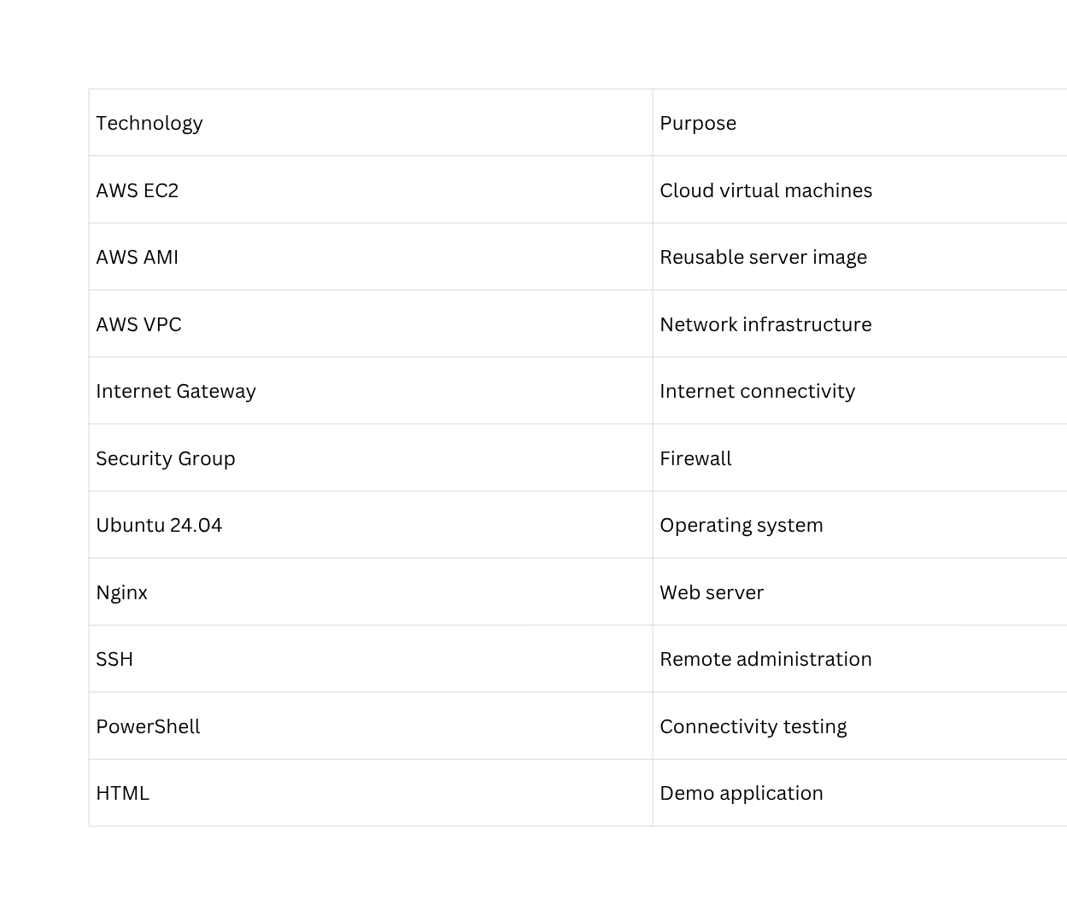
AWS SERVICES USED

Slide 5
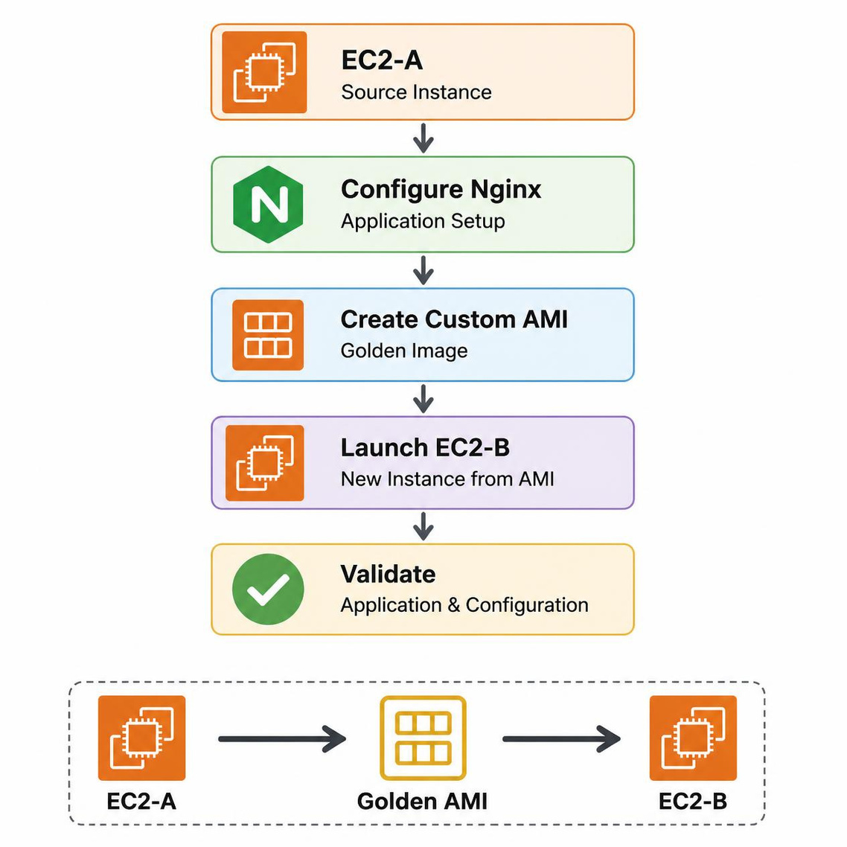
PROJECT ARCHITECTURE

Slide 6
SOURCE EC2 INSTANCE
Implementation Steps
  Open EC2, navigate to Instances, and select Launch Instance.
  Choose either Amazon Linux or Ubuntu.
  Select an appropriate instance type.
  Set up a Key Pair.
  Configure the Security Group with the following rules:
    Allow SSH on Port 22
    Allow HTTP on Port 80
  Launch the instance (EC2-A).
  Connect to the instance via SSH.

Slide 7
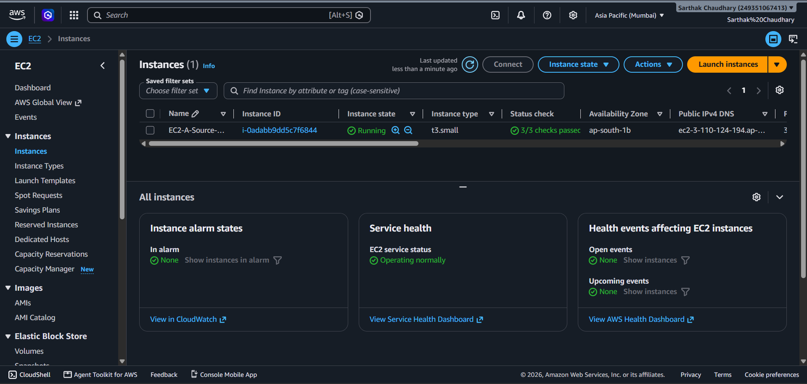

Slide 8
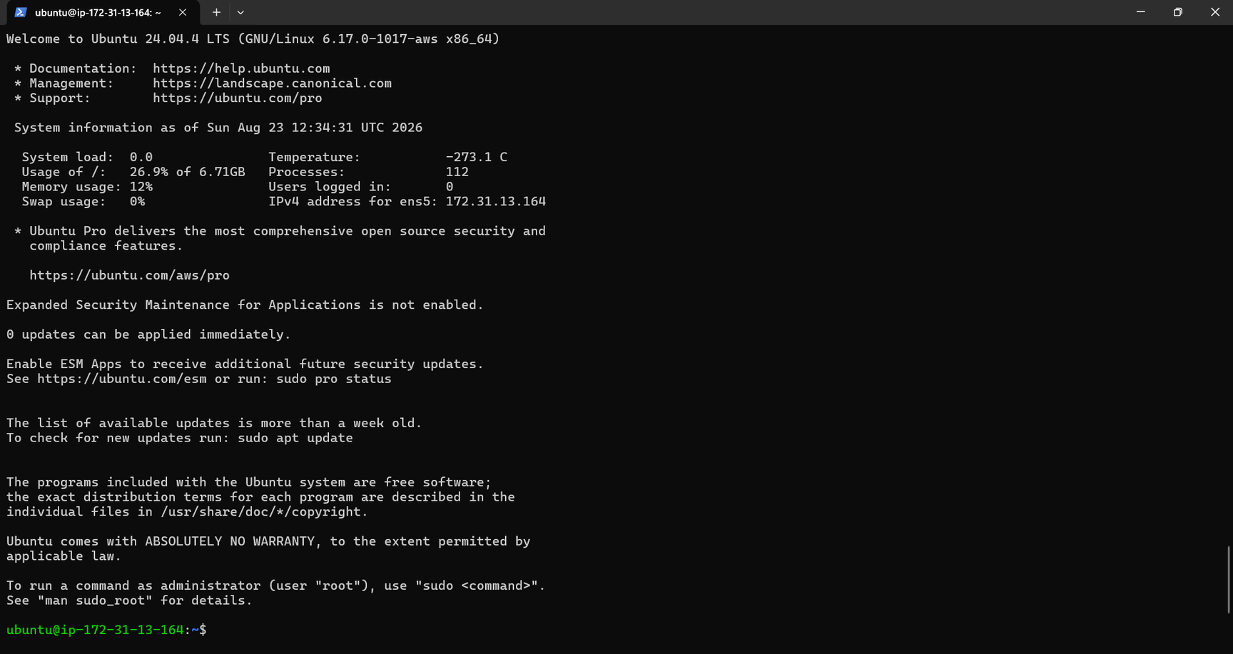

Slide 9
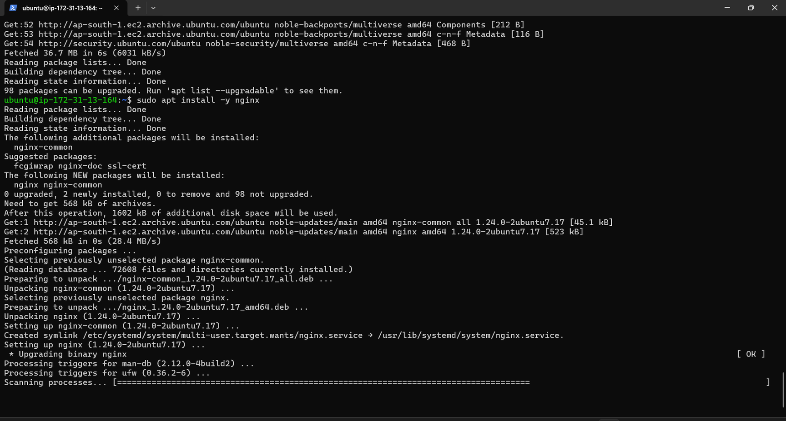
NGINX CONFIGURATION
1- Installed Nginx on the EC2 instance.
2- Enabled and started Nginx service.
3- Configured a custom HTML page.
4- Verified Nginx using EC2 Public IP.
5- Successfully displayed the custom
webpage Validation:

Slide 10
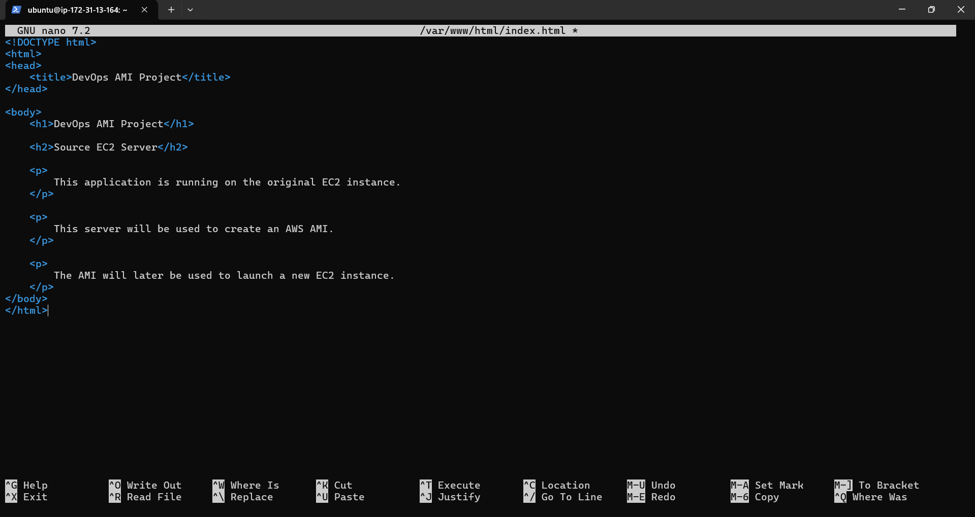

Slide 11
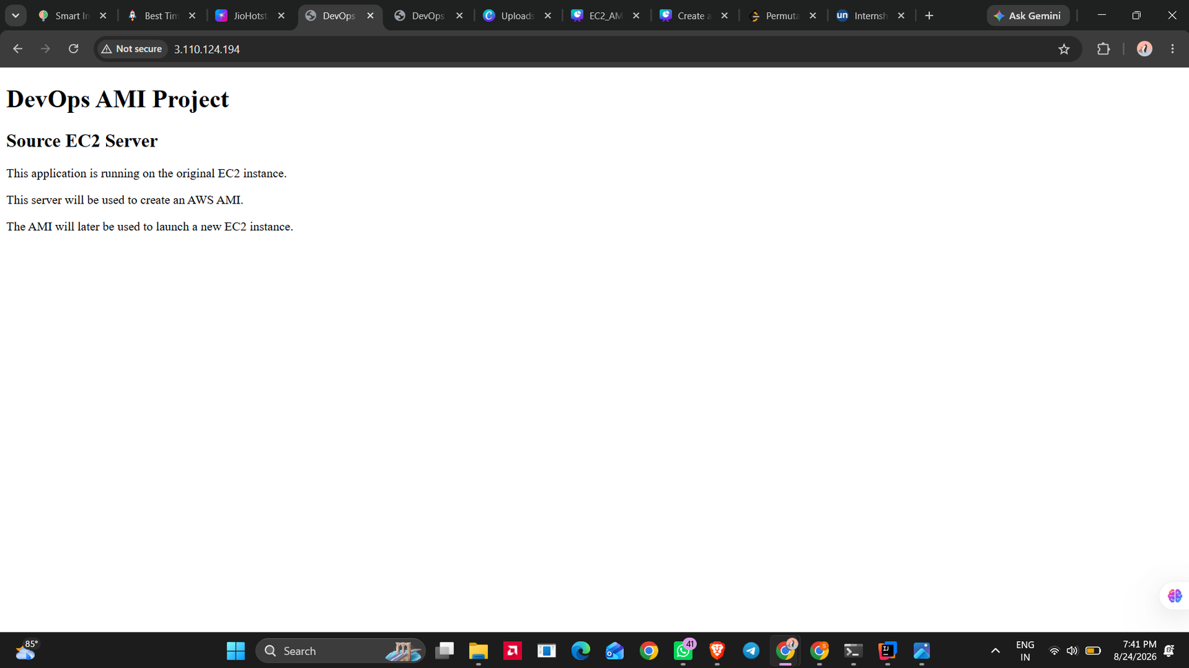

Slide 12
Create Custom AMI
  Select EC2-A
  Go to Actions → Image and templates
  Select Create Image
  Enter AMI name: ”devops-ami-v1”
  Create the AMI
  Wait until the AMI status becomes Available
  Record the AMI ID and Snapshot ID
Result: EC2-A has been converted into a reusable Golden Image.

Slide 13
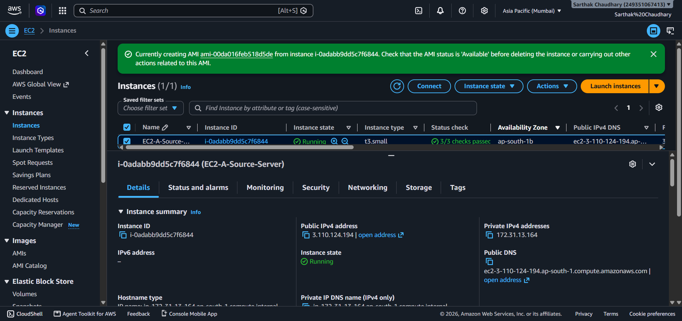

Slide 14
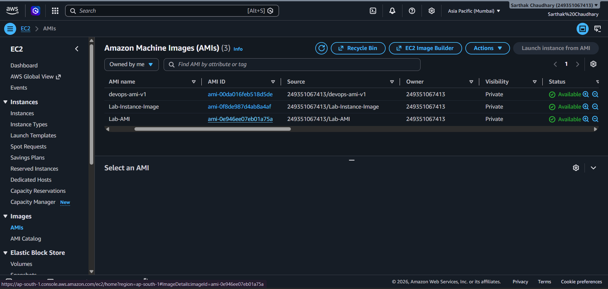

Slide 15
LAUNCH NEW EC2 FROM AMI
  Navigate to EC2 → AMIs → Owned by me.
  Choose “devops-ami-v1”
  Click on **Launch instance from AMI**.
  Configure the following settings:
  Instance Type
    VPC/Subnet
    Key Pair
    Security Group
  Name the instance: EC2-B-AMI-Server.
  Launch the instance and wait for the status checks to confirm success.
# Result → The instance “EC2-B” has been successfully launched from the custom AMI.

Slide 16
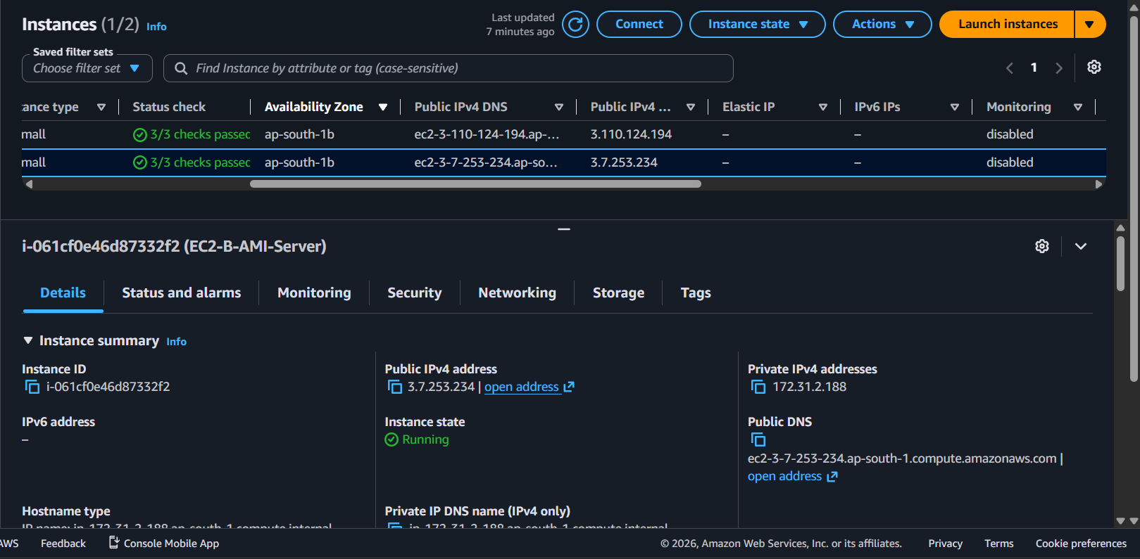

Slide 17
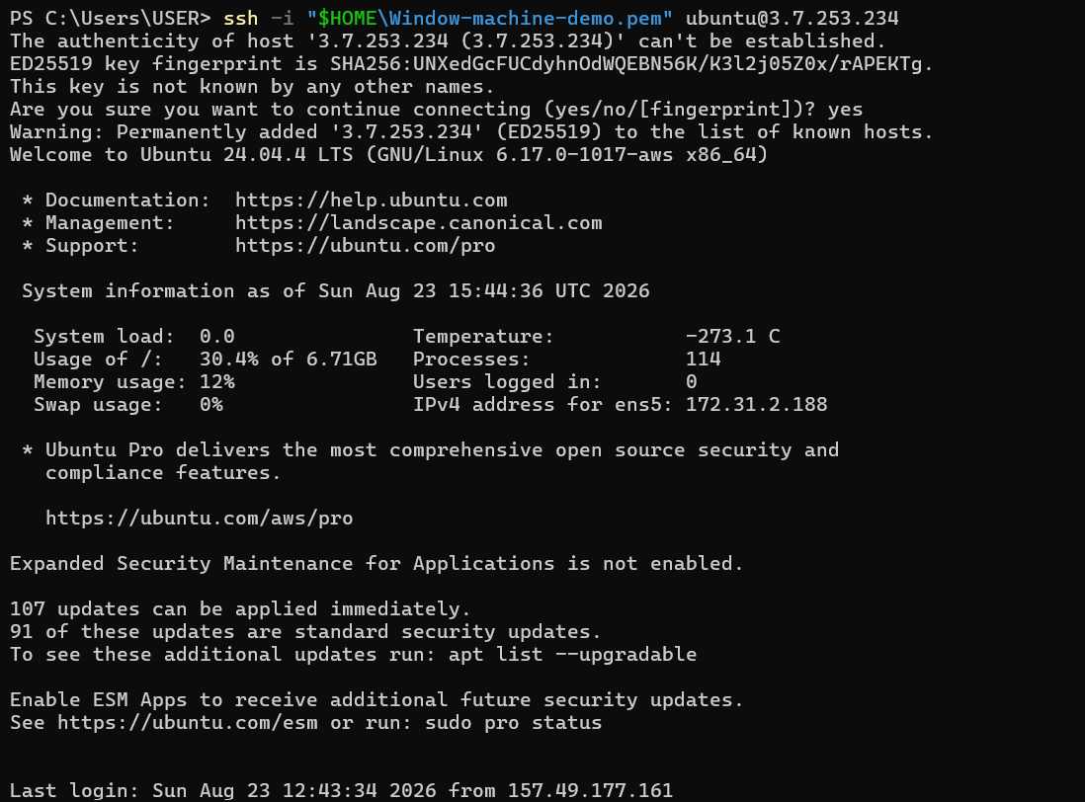

Slide 18
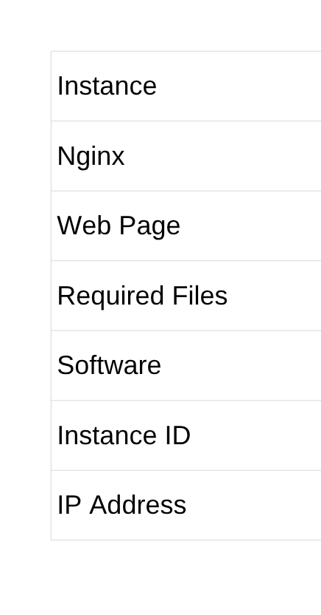
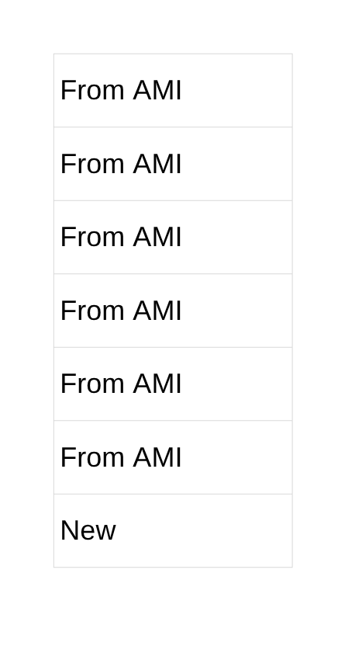
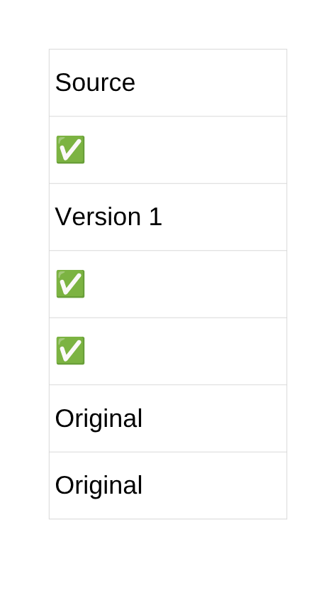
VALIDATION & RESULTS
Validation
EC2-B
EC2-A
Result:- EC2-B is a new instance, but it inherits the expected machine baseline from EC2-A through the custom AMI.

Slide 19
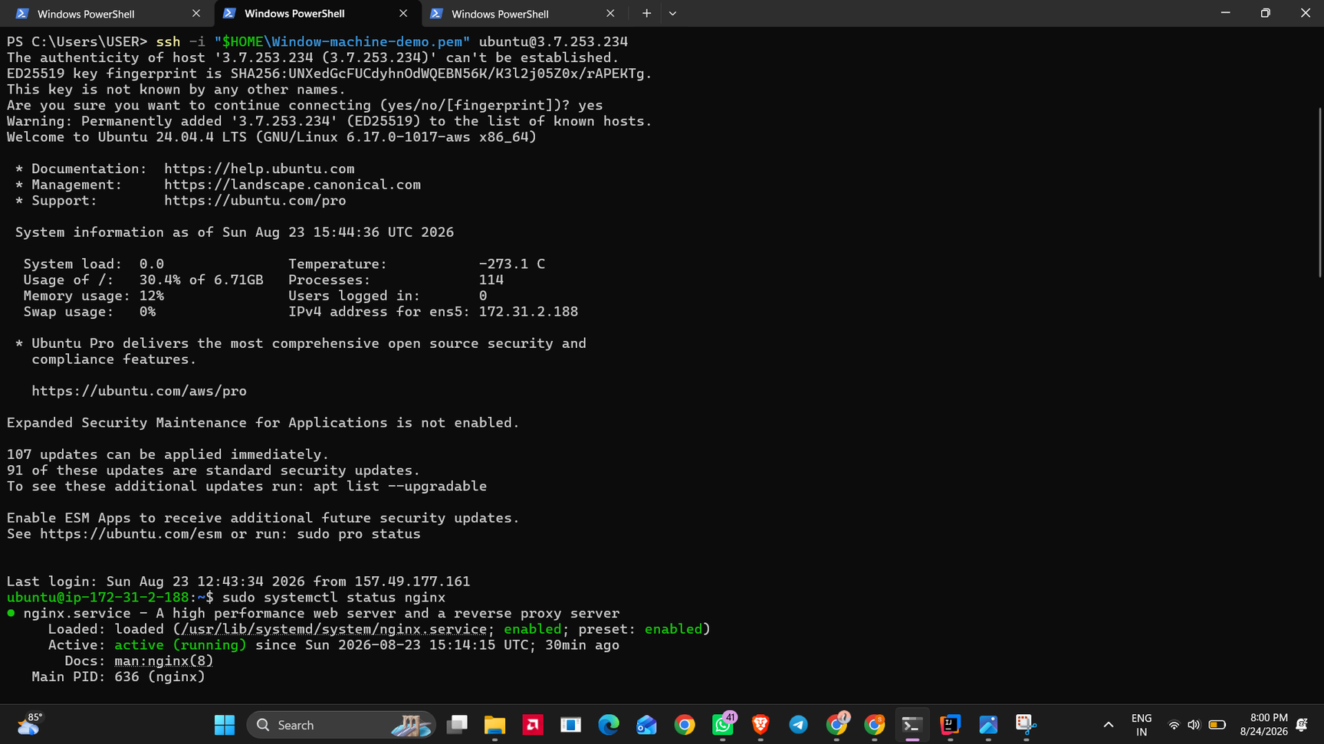

Slide 20
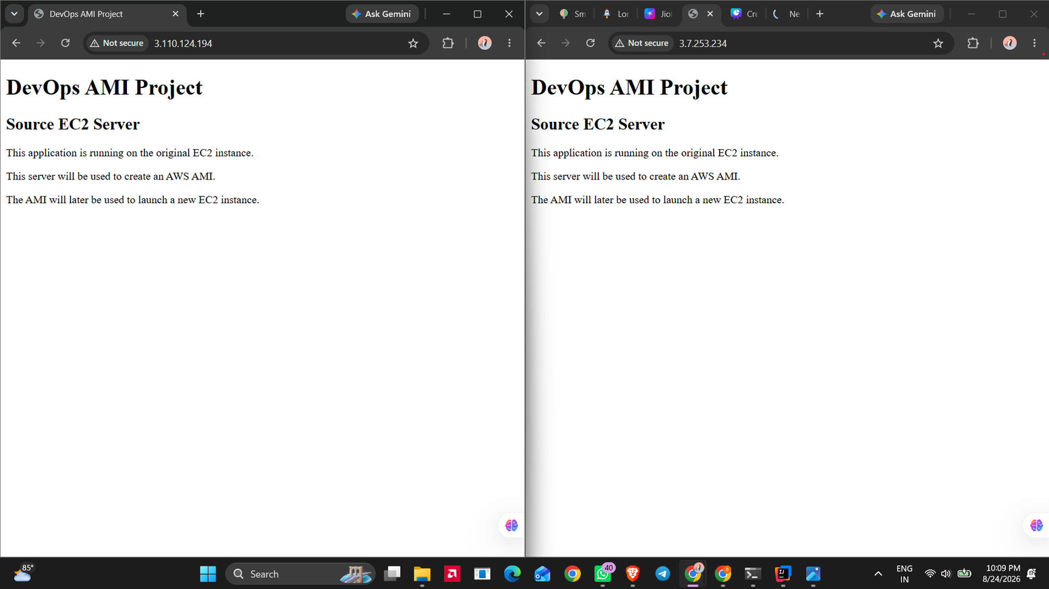

Slide 21
Conclusion
The project successfully demonstrates a repeatable DevOps deployment workflow using AWS EC2 and custom AMIs. A source EC2 server was configured with Ubuntu, Nginx, and a web application. The server was captured as a custom AMI and used to launch a second EC2 instance. The new instance successfully reproduced the required server environment and application, demonstrating consistency, reusability, and faster cloud deployment.

Slide 22
Thank You

